Slide 1

Meme Stock Analysis
BY: ALEX CROITORU
ATRI BATHANI
JAMES JANG
JAVIER PALMA

Slide 2
Agenda
Introduction
Key Findings
Hypothesis
Data Acquisition / Preparation
Data Screener
Technical Indicators
Models
Conclusion

Slide 3





Key Findings

Slide 4
Key Findings
ARIMA model more accurately predicted stock price compared to SVM
Big need for filtering on stop words for Reddit Comments!
Bollinger Bands: Many instances where the stock was more overbought than oversold - typical of “hype” stocks
People will buy into hype
McGinley Dynamic MA is superior at identifying quick and slow momentum in markets
Ultimately not suitable for predicting good entry and exit points for meme stocks

Slide 5
Hypothesis

Slide 6
Hypothesis
Reddit Stock screener would predict what stocks would be good to trade (long, short, options) for a period of 2 days.
Models would predict what were the best indicators to use.
List of most confident to least confident next day trading recommendations
Based on strength and number of indicators backing up the decision.
Provide risk vs expected return thresholds for recommendations based on Sortino (greater than 1.4 is good, less than 0.9 is bad).
Goal: Create a trading algo for mid / large cap stocks implementing ML and sentiment analysis.

Slide 7
Data Acquisition / Preparation

Slide 8
Data Acquisition / Preparation
Data Sources: Reddit; Alpaca
Reddit: WSB forum
Daily / Weekend Discussion Thread, Daily Popular Tickers
Preparation
Retrieved comments through API, ran through sentiment analysis function
Alpaca
Historical Data
Used to train indicators
Preparation
Data was drawn through API function, very little clean-up

Slide 9
Data Screener

Slide 10
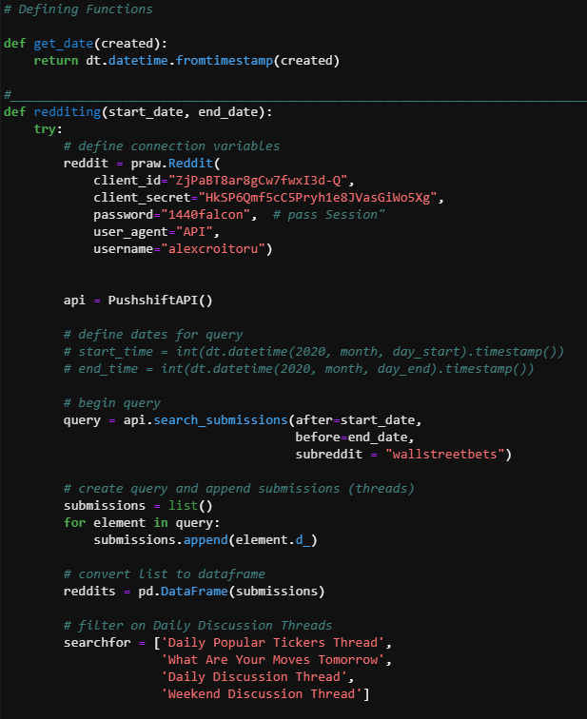
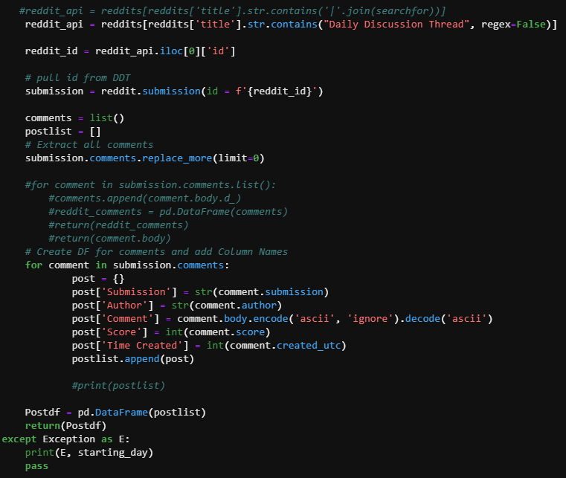

Slide 11
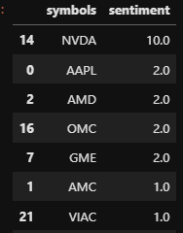
Data Screener
Sentiment Screener
Steps:
Reddit API
Sentiment Analysis for Today - 2

Slide 12
Technical Indicators

Slide 13
Technical Indicators - 11
Reddit Sentiment Analysis
Volume
Daily Return Percentage
McGinley Dynamic Moving Average: A technical indicator that improves upon moving average lines by adjusting for shifts in market speed.
MACD: A trend-following momentum indicator that shows the relationship between two moving averages of a security’s price. The MACD is calculated by subtracting the 26-period exponential moving average (EMA) from the 12-period EMA.
RSI: A momentum indicator used in technical analysis that measures the magnitude of recent price changes to evaluate overbought or oversold conditions in the price of a stock or other asset.
Stochastic: Show when the asset you trade is oversold or overbought. It signals when the market’s momentum is slowing down.
%D
%K
Fast/slow close
Long/short crossover
Fast/slow volatility
Bollinger bands

Slide 14
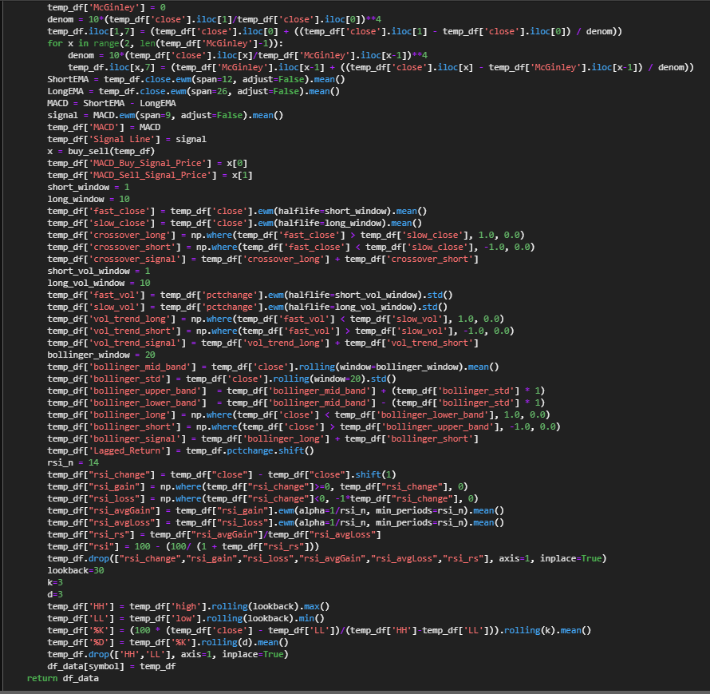
Technical Indicators Creation

Slide 15
Models

Slide 16
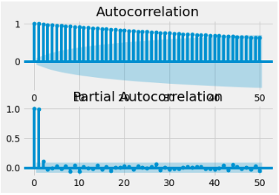
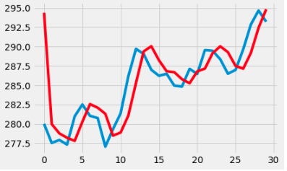
Models
ARIMA Model: Forecasting time series using past values
ADF Statistic: -6.685075
p-value: 0.000000
Critical Values:
1%: -3.444
5%: -2.867
10%: -2.570

Slide 17
Models
SVM
Takes in data to find patterns
Based on all indicators
Logistic Regression
Ran for sentiment analysis
80/20 split, predicted values were the sentiment (-1 to 1) on the comments filtered on defined stock tickers (SP500)

Slide 18
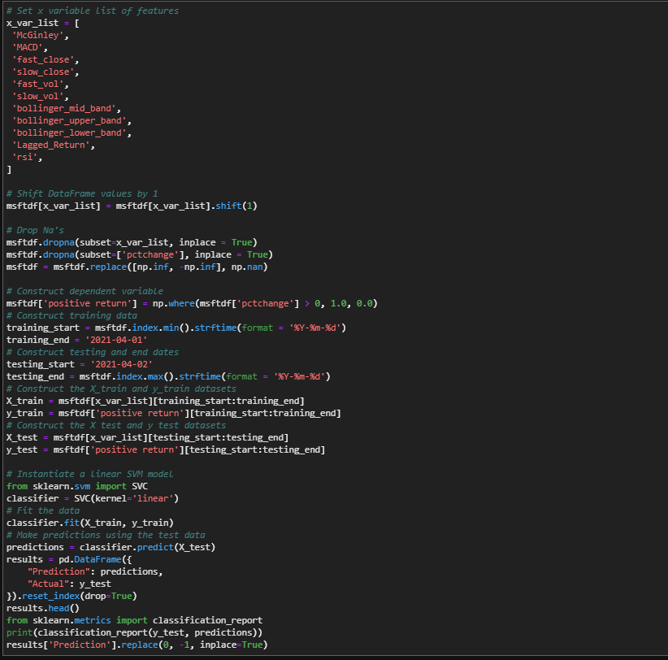
SVM Model

Slide 19
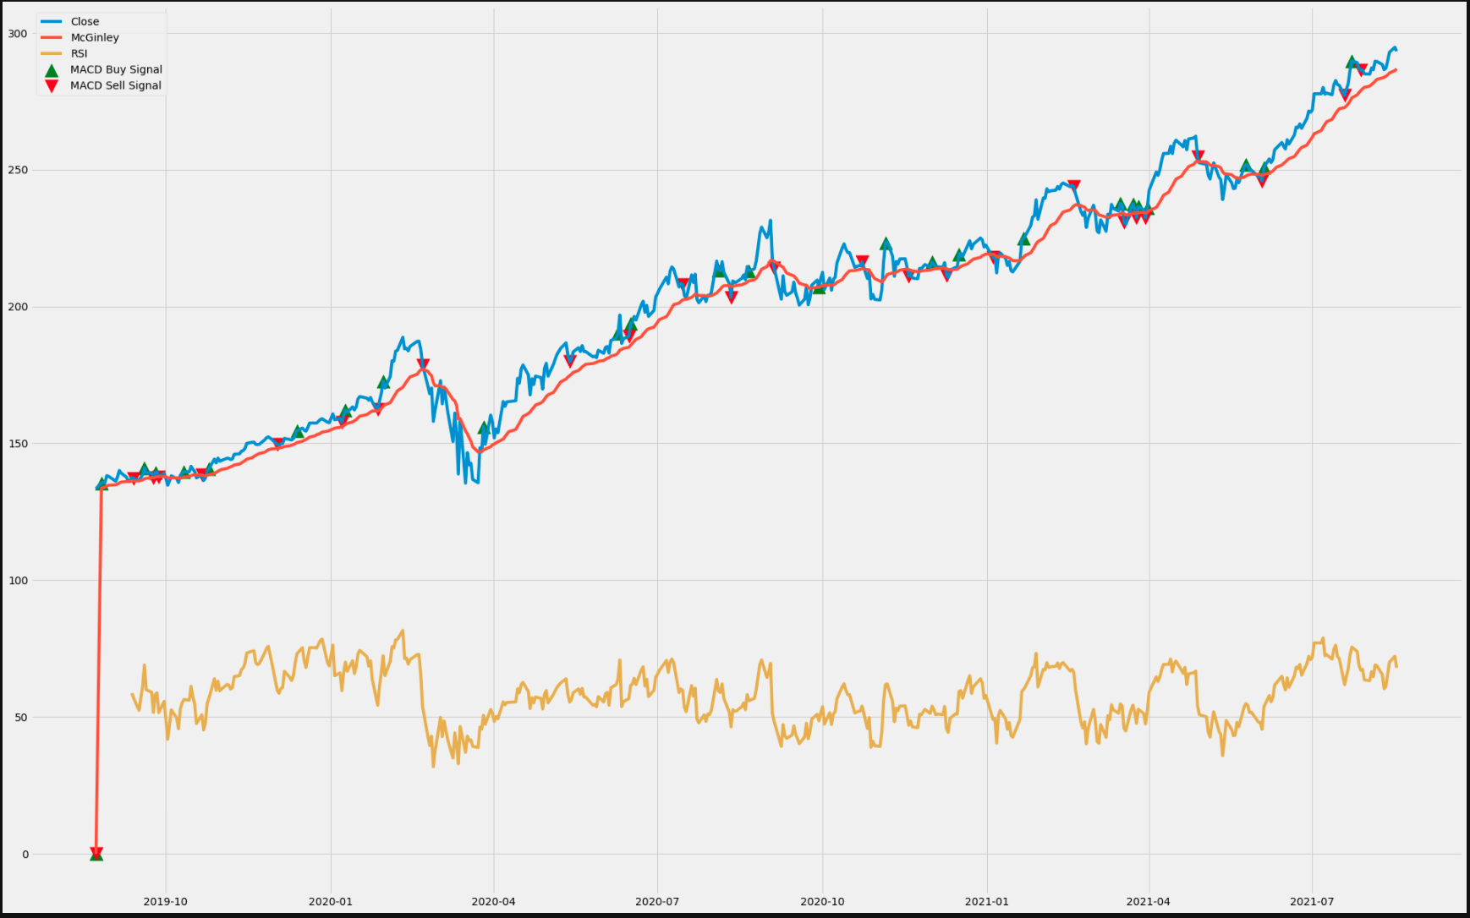

Slide 20
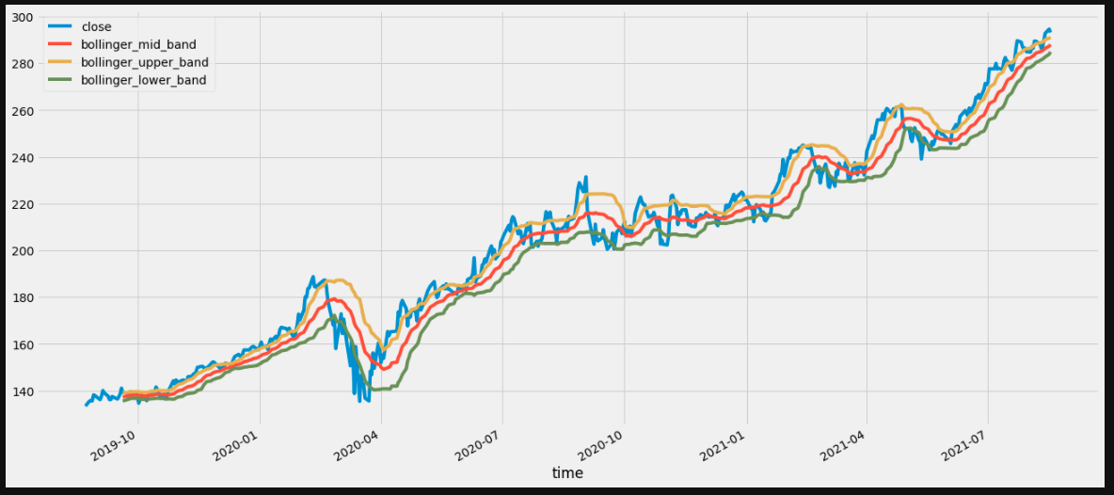

Slide 21
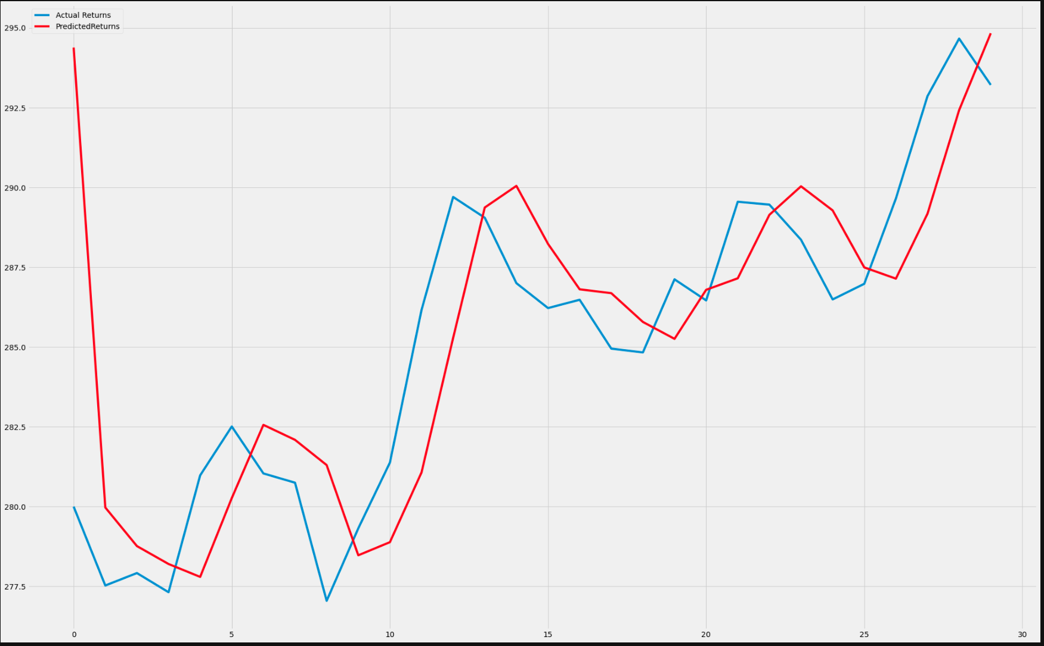

Slide 22
Conclusion
Extracted Data from Alpaca
Created Indicators
Extracted posts from reddit
Sentiment Analysis
Most popular posts
Used indicators in both models to determine price action
ARIMA model more accurately predicted stock price compared to SVM

